Slide 1
Introduction to Arduino Microcontrollers

Slide 2
Overview
Background
Microcontroller defined/Why Arduinos ?
Types of Arduino microcontrollers
What To Get (Hardware and Software)
Arduino C (Embedded C)
Electronic Circuits

Slide 3
Microcontrollers – One Definition
A microcontroller is a computer present in a single integrated circuit which is dedicated to perform one task and execute one specific application.
It contains memory, programmable input/output peripherals as well a processor. Microcontrollers are mostly designed for embedded applications and are heavily used in automatically controlled electronic devices such as cellphones, cameras, microwave ovens, washing machines, etc.
Source of information

Slide 4
Arduino – Official Definition
Taken from the official web site http://www.arduino.cc
Arduino is an open-source electronics prototyping platform based on flexible, easy-to-use hardware and software. It's intended for artists, designers, hobbyists, and anyone interested in creating interactive objects or environments.

Slide 5
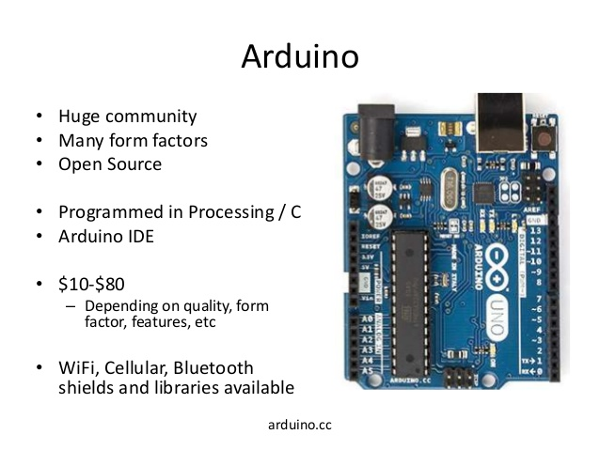
Advantages of Arduino over traditional M.C.

Slide 6
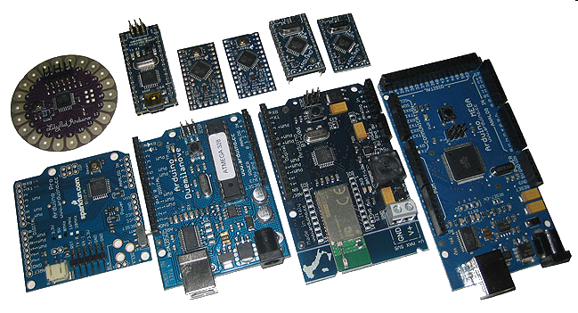
Types of Arduino:
Many different versions have different utility environment which varies:
Number of input/output channels
Form factor
Processor
Leonardo
Due
Micro
LilyPad
Esplora
Uno

Slide 7
Different Types of Arduinos:
Arduino Board | Processor | Memory | Digital I/O | Analogue I/O
Arduino Uno | 16Mhz ATmega328 | 2KB SRAM, 32KB flash | 14 | 6 input, 0 output
Arduino Due | 84MHz AT91SAM3X8E | 96KB SRAM, 512KB flash | 54 | 12 input, 2 output
Arduino Mega | 16MHz ATmega2560 | 8KB SRAM, 256KB flash | 54 | 16 input, 0 output
Arduino Leonardo | 16MHz ATmega32u4 | 2.5KB SRAM, 32KB flash | 20 | 12 input, 0 output
Arduino Pro Mini | 16Mhz ATmega328p SMD | 2KB SRAM, 32KB flash | 14 | 6 input, 0 output

Slide 8
Our Need and Selection:
We are selecting Arduino Uno for prototyping
And Arduino Pro Mini for Final presentation
We need roughly 5 Inputs and 3 Outputs.
For our need and computational needs Arduino UNO with 16MHz clock frequency and 32KB of flash + EEPROM is sufficient.
We will use UNO for testing the circuit after each iteration and module verification and Pro Mini for the final implementation of the circuit.

Slide 9
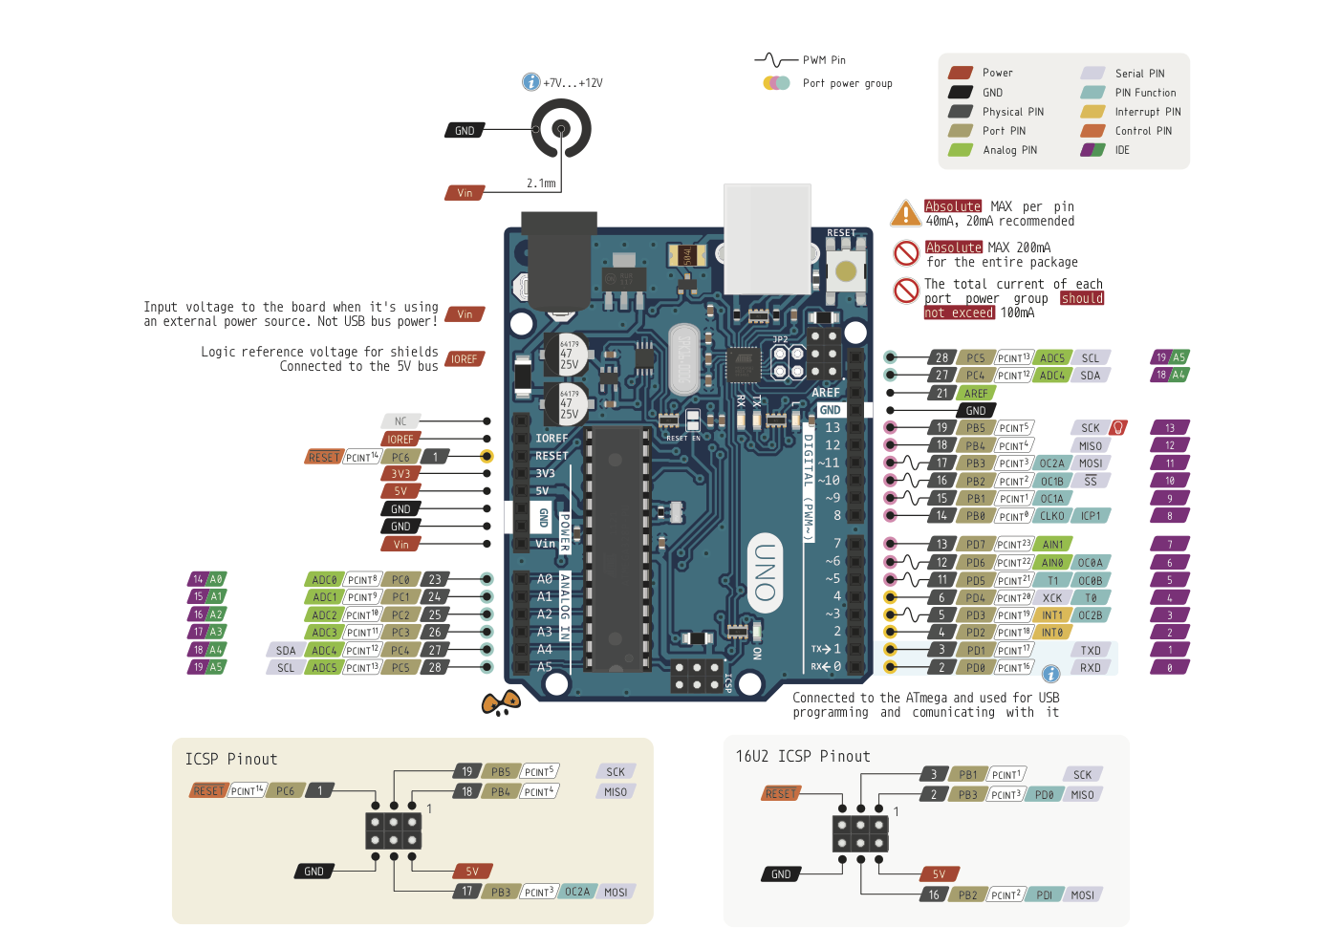
Architecture & Pinout of Arduino UNO: Source

Slide 10
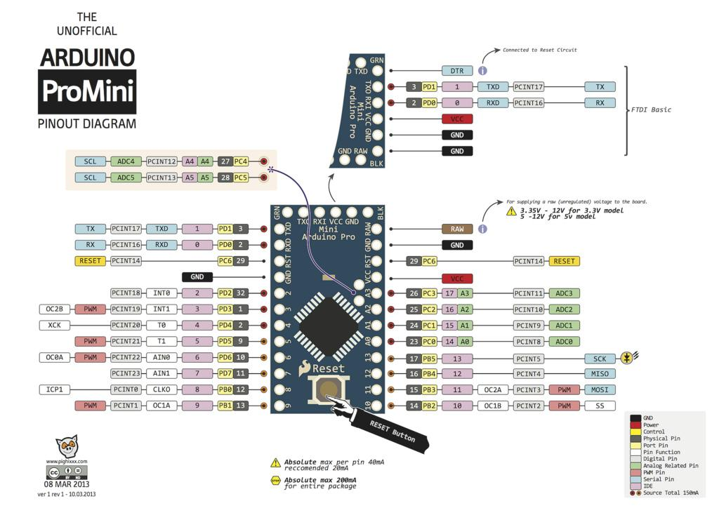
Architecture & Pinout of Arduino Pro Mini: Source

Slide 11
Introduction to Arduino IDE
(Integrated Development Environment):
Arduino microcontrollers are programmed using the Arduino IDE
Can be downloaded for free from here.
Arduino programs, called “sketches”, are written in a programming language similar to C and C++.
Every sketch must have a setup() function (executed just once) followed by a loop() function (potentially executed inf times); add “comments(//)” to code to make it easier to read.
Many sensors and other hardware devices come with prewritten softwares called libraries or binaries, like lcd.h, math.h etc.

Slide 12
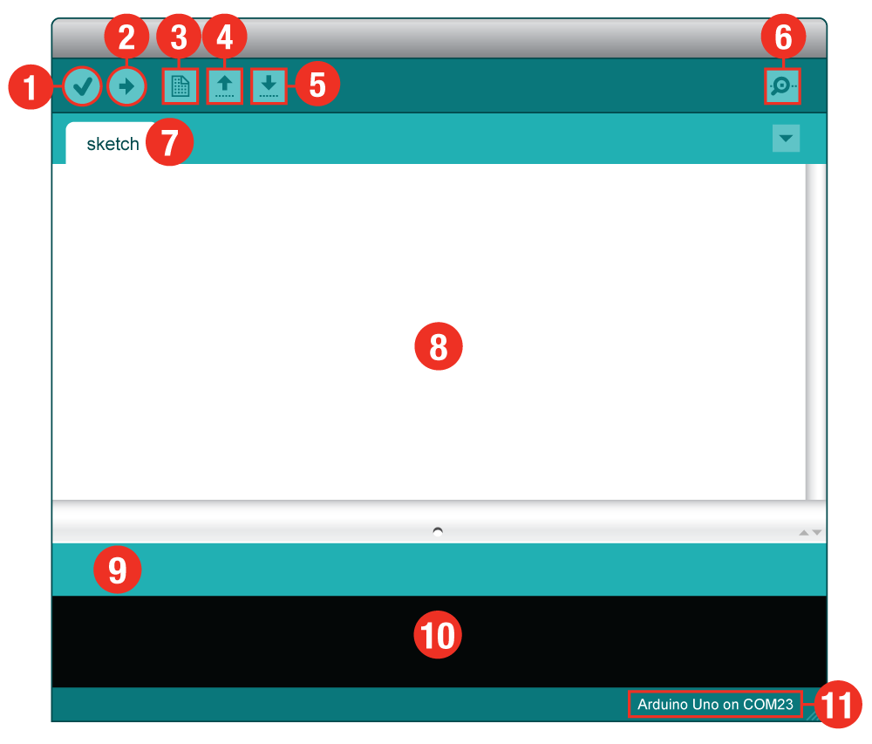
Parts of IDE in Main Screen: Source
Verify or Compile.
Upload to Board.
New Sketch.
Open file.
Save sketch.
Serial Monitor.
Sketch Name.
Code Area.
Message Area.
Text Console.
Board and Serial Port.

Slide 13
Description of IDE shown in the previous slide:
Verify: Compiles and approves your code. It will catch errors in syntax (like missing semi-colons or parenthesis).
Upload: Sends your code to the RedBoard. When you click it, you should see the lights on your board blink rapidly.
New: This buttons opens up a new code window tab.
Open: This button will let you open up an existing sketch.
Save: This saves the currently active sketch.
Serial Monitor: This will open a window that displays any serial information your RedBoard is transmitting. It is very useful for debugging.
Sketch Name: This shows the name of the sketch you are currently working on.
Code Area: This is the area where you compose the code for your sketch.
Message Area: This is where the IDE tells you if there were any errors in your code.
Text Console: The text console shows complete error messages. When debugging, the text console is very useful.
Board and Serial Port: Shows you what board and the serial port selections

Slide 14
Arduino Program Development
Based on C++ without 80% of the instructions.
A handful of new commands.
Programs are called 'sketches'.
Sketches need two functions:
void setup( )
void loop( )
setup( ) runs first and once.
loop( ) runs over and over, until power is lost or a new sketch is loaded.

Slide 15
Arduino C
Arduino sketches are centered around the pins from pinout on an Arduino board.
Arduino sketches always loop.
void loop( ) {} is equivalent to while(1) { }
The pins can be thought of as global variables.

Slide 16
Arduino C Specific Functions
pinMode(pin, mode)
Designates the specified pin for input or output
digitalWrite(pin, value)
Sends a voltage level to the designated pin
digitalRead(pin)
Reads the current voltage level from the designated pin
analog versions of above
analogRead's range is 0 to 1023
serial commands
print, println, write

Slide 17
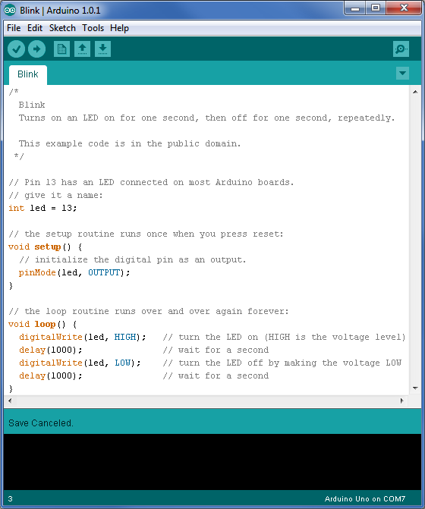
Compiler Features
Numerous sample sketches are included in the compiler
Located under File, Examples
Once a sketch is written, it is uploaded by clicking on File, Upload, or by pressing <Ctrl> U

Slide 18
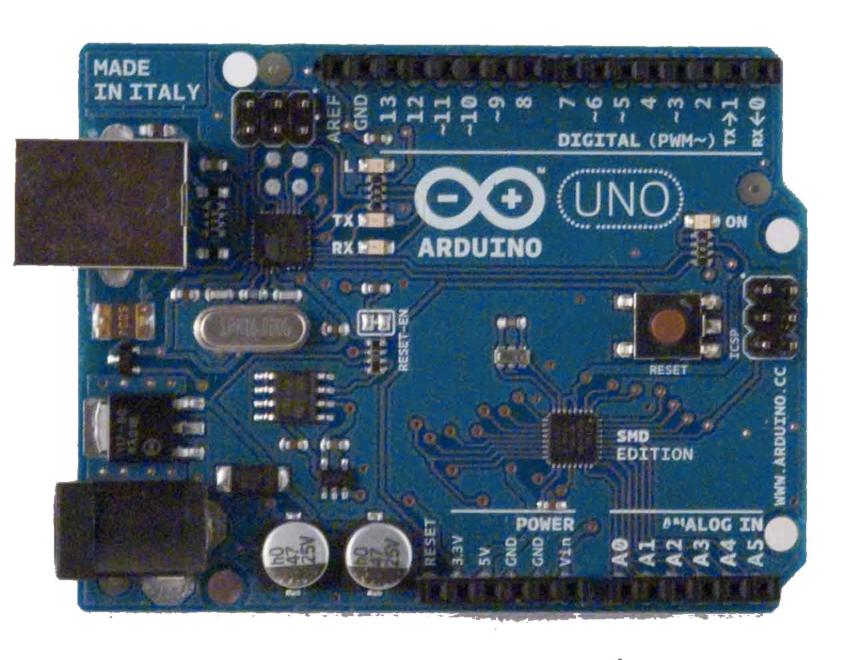
Blink Sketch
void setup( )
{
pinMode(13, OUTPUT);
}
void loop( )
{
digitalWrite(13, HIGH);
delay(1000);
digitalWrite(13, LOW);
delay(1000);
}
Connected to one end of the circuit
Connected to other end of the circuit

Slide 19
Inputs
Digital inputs will come to the Arduino as either on or off (HIGH or LOW, respectively).
HIGH is 5VDC.
LOW is 0VDC.
Analog inputs will come to the Arduino as a range of numbers, based upon the electrical characteristics of the circuit.
0 to 1023
.0049 V per digit (4.9 mV)
Read time is 100 microseconds (10,000 a second)

Slide 20
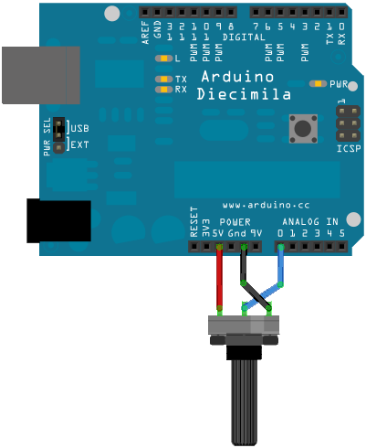
Analog Input
A potentiometer (variable resistor) is connected to analog pin 0 to an Arduino.
Values presented to pin 0 will vary depending upon the resistance of the potentiometer.

Slide 21
Analog Input-Application
The variable resistor can be replaced with a sensor.
For example, a photo resistor.
Depending upon the light level at the photo resistor:
Turn on a light
Increase or decrease the brightness of an LED (or an LED array)
Most sensors are simply variable resistors, but vary their resistance based on some physical characteristic.

Slide 22
Sensors
Sensors can be both binary or a range.
Usually, sensors that measure a range of values vary their resistance to reflect their detection.
Arduinos can only sense voltages, not resistances.
Sensors that only vary their resistances require a circuit called a voltage divider to provide the Arduino a voltage.

Slide 23
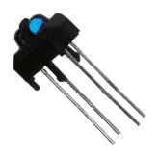
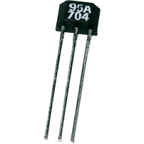
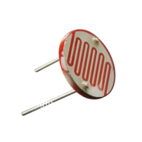
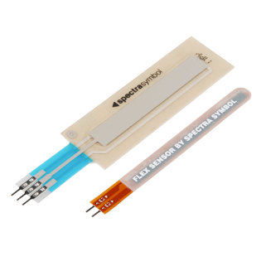
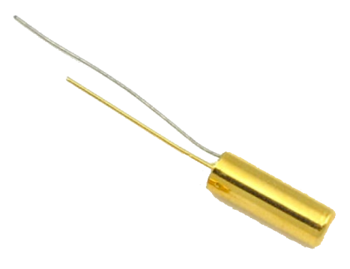
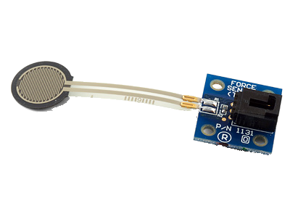
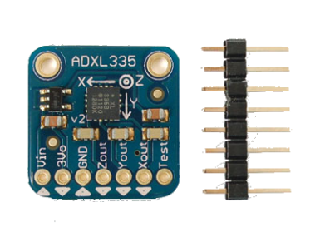
Common Sensors
Dials on a radio are simply potentiometers
Temperature
Light
Angle
Switches
did the user throw a switch or push a button?
Accelerometer (measures motion and tilt)
Infrared sensor & light
Hall effect sensor and magnet
Ball tilt sensor (for measuring orientation)
Force

Slide 24
Alternatives to the Arduino
PIC controller
Microcontroller programmed with C or assembler
Alternatives to the Arduino line
Pinguino – PIC controller
MSP430 – Texas Instruments; $4.30
Others: customs, Teensy, etc.
Netduino
Computers
Raspberry Pi
BeagleBones – TI; has computer and controller

Slide 25
Thank You

